Slide 1
Computer Security?
Computer Security is concerned with the deployment of measures to ensure the protection of computer systems from hostile acts or influences

Slide 2
Security in Context
Security Attack: Any action that compromises the security of information.
Security Mechanism: A mechanism that is designed to detect, prevent, or recover from a security attack.
Security Service: A service that enhances the security of information systems and information transfers. A security service makes use of one or more security mechanisms.

Slide 3
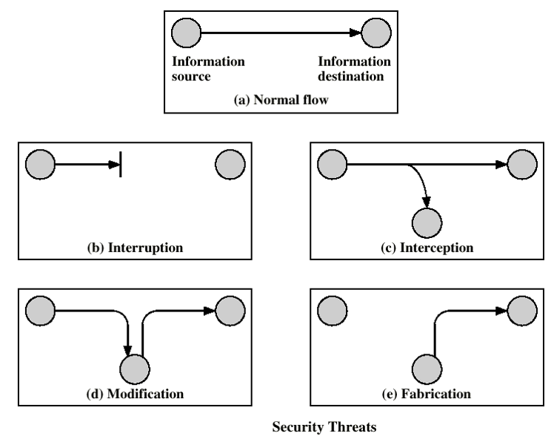
Security Attacks

Slide 4
Security Attacks
Interruption: This is an attack on availability
Interception: This is an attack on confidentiality
Modification: This is an attack on integrity
Fabrication: This is an attack on authenticity

Slide 5
aspects of security model
Confidentiality
Integrity
Availability

Slide 6
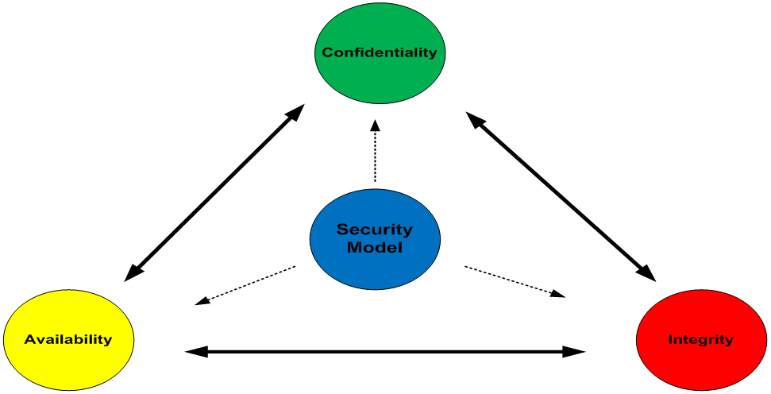
aspects of security model

Slide 7
Security Services
Confidentiality (privacy)
Authentication (who created or sent the data)
Integrity (has not been altered)
Non-repudiation (the order is final)
Access control (prevent misuse of resources)
Availability (permanence, non-erasure)
  Denial of Service Attacks
  defence against malware

Slide 8
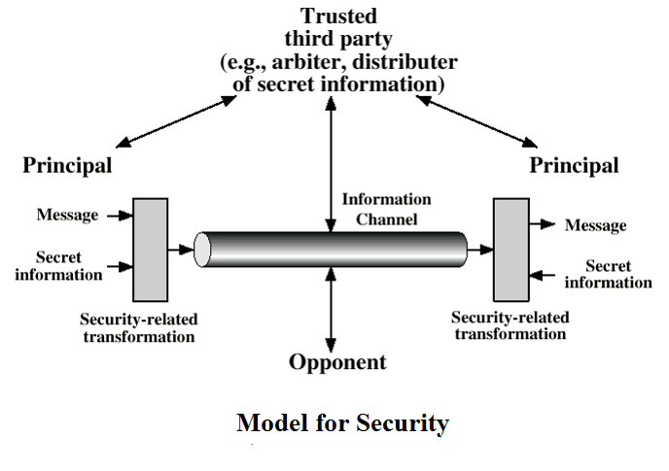

Slide 9
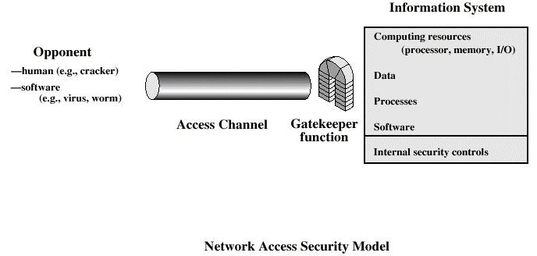

Slide 10
Methods of Defence
Encryption
Software Controls (access limitations in a data base, in operating system protect each user from other users)
Hardware Controls (smartcard)
Policies (frequent changes of passwords)
Physical Controls

Slide 11
Security Policy
specification
  what is the security scheme supposed to do?
  codify in policy and procedures
implementation/mechanisms
  how does it do it?
  prevention, detection, response, recovery
correctness/assurance
  does it really work?
  assurance, evaluation
Notes:
We conclude this chapter with a brief look at the overall strategy for providing computer security. [LAMP04] suggests that a comprehensive security strategy involves three aspects:
• Specification/policy: What is the security scheme supposed to do? A security policy is an informal description of desired system behavior. In developing a security policy, a security manager needs to consider the context, in terms of: value of the assets being protected; vulnerabilities of the system; potential threats and the likelihood of attacks. Further, the manager must consider the following tradeoffs between “Ease of use versus security” and “Cost of security versus cost of failure and recovery”.
• Implementation/mechanisms: How does it do it? Security implementation involves four complementary courses of action: prevention (ideal security scheme is when no attack is successful. Not practical in all cases, is a reasonable goal), detection (when practical to detect security attacks), response (to halt the attack and prevent further damage), recovery (from attack consequences, such as using a backup system).
• Correctness/assurance: Does it really work? Have the concepts of assurance and evaluation. Assurance as the degree of confidence one has that the security measures, both technical and operational, work as intended to protect the system and the information it processes. Evaluation is the process of examining a computer product or system with respect to certain criteria. Evaluation involves testing, and may also involve formal analytic or mathematical techniques.

